Slide 1

CSE- 410
Software Development
Lab: 02
Fahad Ahmed
Lecturer, Dept. of CSE
E-mail: fahadahmed@uap-bd.edu

Slide 2
Course Synopsis
Students have to develop on real life oriented projects that means solve a complex engineering problem in this course. Web technologies (ASP. Net, PHP, Ajax, Java Script, Joomla, and so on) and Database (DB2, Oracle, SQL Server, MySQL, and so on) are preferred for the development. Open Source projects are also preferred as Open source code is typically created through a collaborative effort in which programmers improve upon the code and share the changes within the community. Moreover, documentation is a major concern for the project to ensure the Software Quality Assurance (SQA). Hence at the end of semester students submit their projects including the documentation.

Slide 3
Project Groups
Project group
maximum 3 members**

Slide 4
Assessment
Assessment Type | % weight
Project Evaluation (Assessment) | 70%
Continuous Evaluation in Lab | 30%
Presentation | 20%
Viva | 20%
Report (Doc + Video) and CEP Mapping | 30%
Total | 100%

Slide 5
CO-PO
CO No. | CO Statements: Upon successful completion of the course, students should be able to: | Corresponding POs
CO1 | Identify, formulate, and analyze a real world problem based on requirement analysis. | 2-Problem Analysis
CO2 | Design/Develop a working solution on a real world problem using s/w designing tools. | 3-Design/ development of solutions
CO3 | Use modern development tools which are popular among s/w developers. | 5-Modern Tool Usage
CO4 | Identify societal, health, safety, legal and cultural issues related to the project. | 6-The Engineer and Society
CO5 | Practice professional ethics and responsibilities and norms of engineering practice. | 8-Ethics

Slide 6
CO-PO
CO No. | CO Statements: Upon successful completion of the course, students should be able to: | Corresponding POs
CO6 | Work as a team and fulfil individual responsibility. | 9-Individual and Team work
CO7 | Communicate effectively through presentation and write effective reports and documentations on the project. | 10-Communication
CO8 | Apply project management principles using Version Control System, and produce cost value analysis. | 11-Project Management and Finance
CO9 | Recognize the need for, and have the preparation and ability to engage in independent and life-long learning in the broadest context of requirement changes and introduction of modern development tools | 12-Lifelong learning
CO10 | Apply the S/W Engineering knowledge to provide a working solution on a real world problem | 1-Engineering Knowledge

Slide 7
Weighting COs with Assessment methods
Assessment Type | % weight | CO1 | CO2 | CO3 | CO4 | CO5 | CO6 | CO7 | CO8 | CO9 | CO10
Presentation | 20% | 10 |  |  | 5 |  |  | 5
Report and CEP Mapping | 30% | 5 | 5 |  | 3 | 5 |  | 2 | 5 | 5
Viva | 20% |  |  |  | 2 | 5 | 5 | 3 |  | 5
Continuous Project Evaluation (Assessment) | 30% |  | 10 | 5 |  |  | 5 |  | 5 |  | 5
Total | 100% | 15 | 15 | 5 | 10 | 10 | 10 | 10 | 10 | 10 | 5

Slide 8
PO Attainment
Final Year Project
Final Year Project
Final Year Design Project
Final Year Thesis-Project
Final Year Courses
Final Year Courses
Third Year Courses
Third Year Courses
Second Year Courses
Second Year Courses
Knowledge and Skills
First Year Courses
First Year Courses

Slide 9
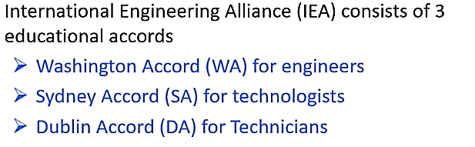
IEA and CEP
According to Washington Accord
Knowledge Profile (K)
Level of Problem Solving(P)
Attributes(A)

Slide 10
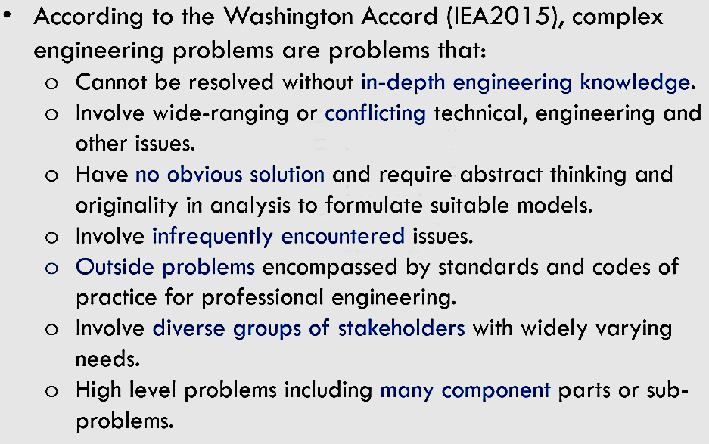

Complex Engineering Problems
How to Demonstrate through Projects?

Slide 11
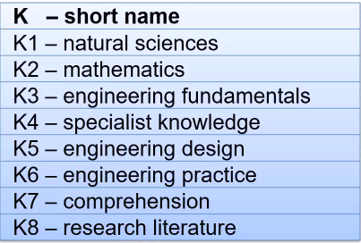
Complex Engineering Problems :
Knowledge Profile (K)

Slide 12
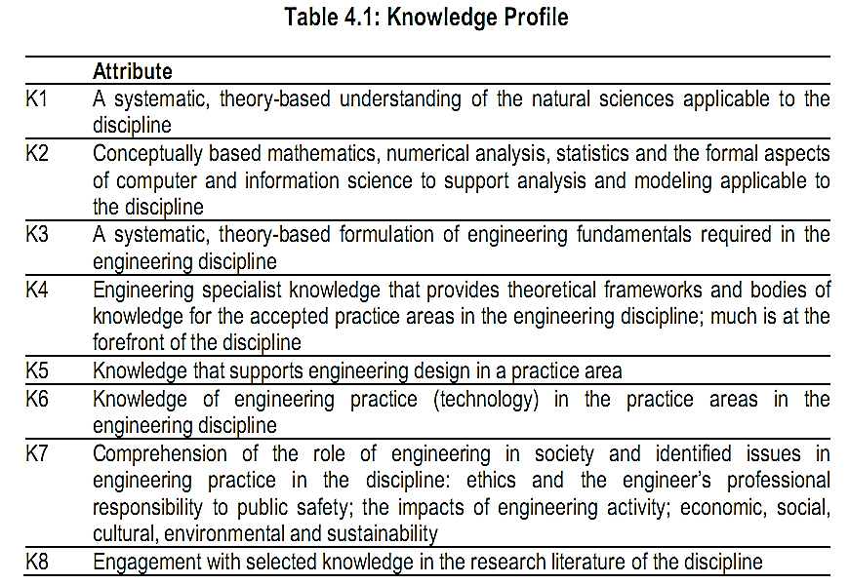
Complex Engineering Problems

Slide 13
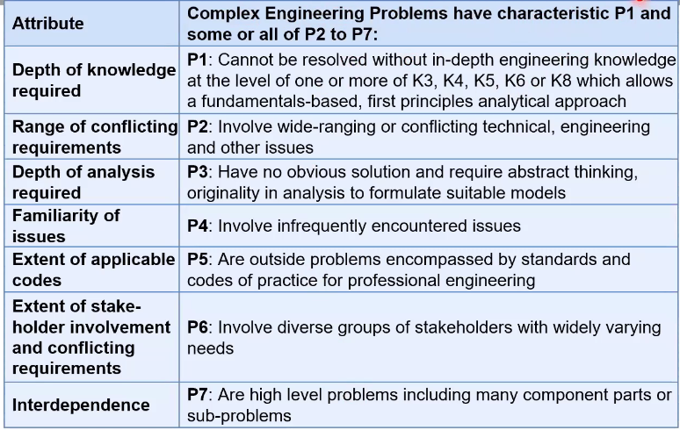
Complex Engineering Problem Solving (P)

Slide 14
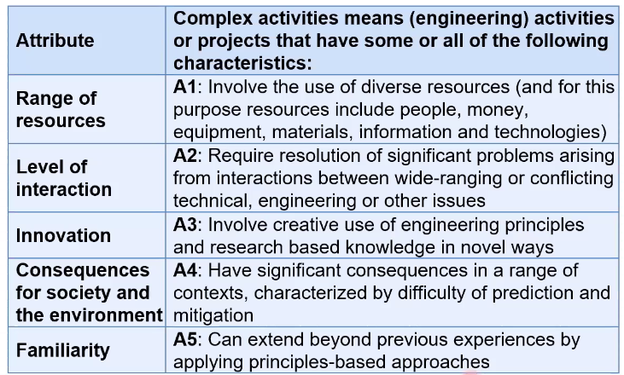
Complex Engineering Activities (A)

Slide 15
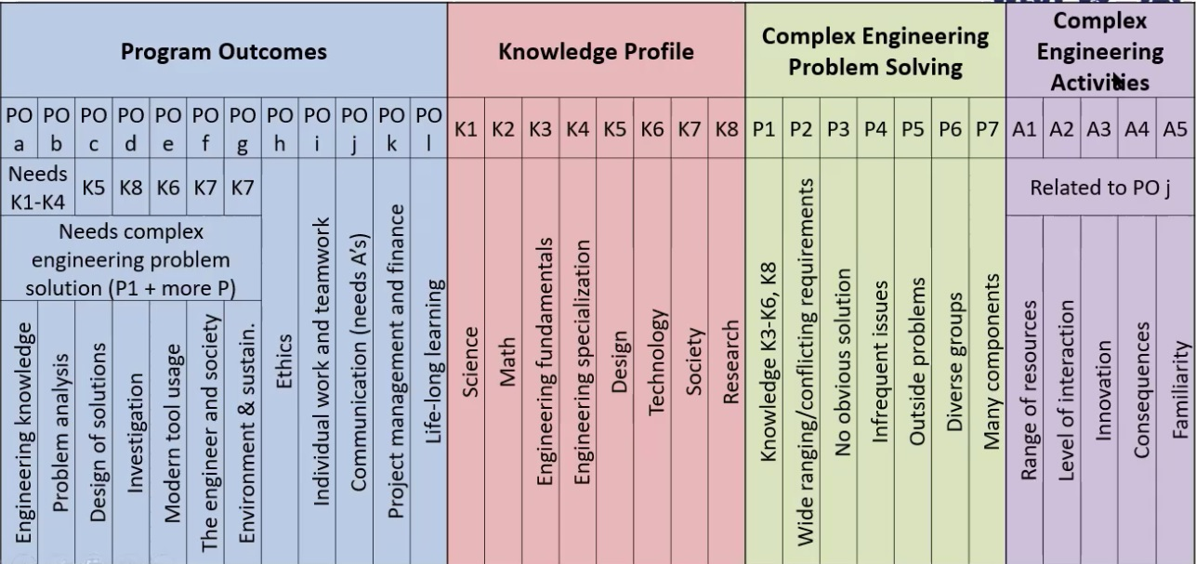
Complex Engineering Problems

Slide 16
Project Idea
This are not complex engineering problem (CEP), try to make it into CEP
https://nevonprojects.com/year-projects-for-computer-engineering/
https://1000projects.org/

Slide 17
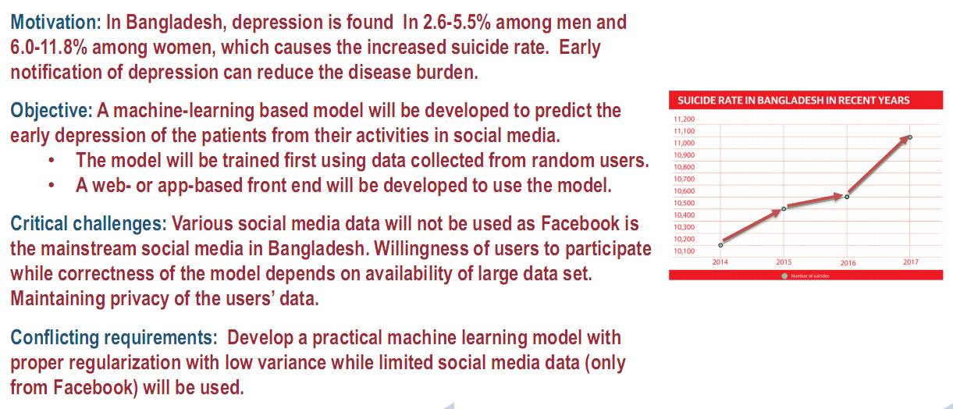
Complex Engineering Problem

Slide 18
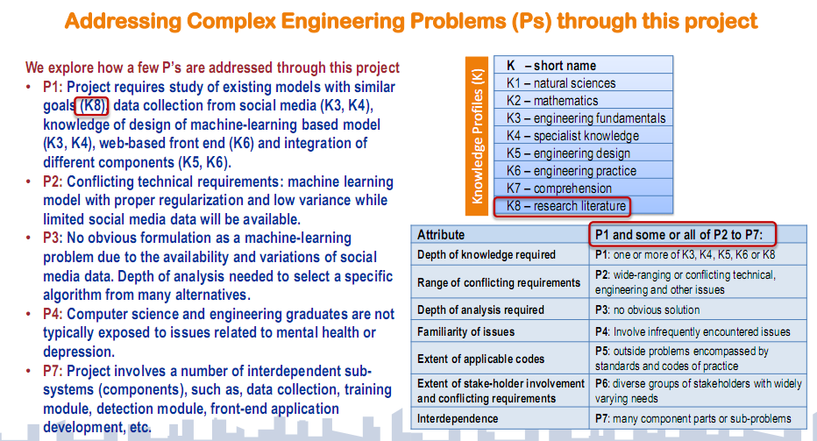
Complex Engineering Problem

Slide 19
Complex Engineering Problem
Design a simple Bangla Speech Recognition system.
Such a system can be incorporated with a wheelchair to make it voice controlled and thus enables a physically handicapped person to move freely without the help of a constant care-giver. Moreover, the ability to give commands in Bangla will make the system more user-friendly in the context of Bangladesh.
The system should be speaker-independent, i.e. it is required that the Bangla speech recognition system should work satisfactorily irrespective of sex, age-group, or dialect of the speaker.
Students are required to explore different methodologies to investigate the problem through design of experiment and data analysis and select or develop an optimal methodology for design of the system.

Slide 20
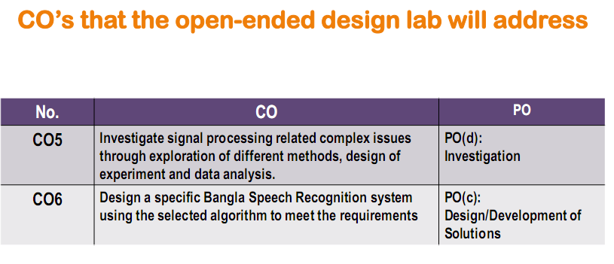
Complex Engineering Problem

Slide 21
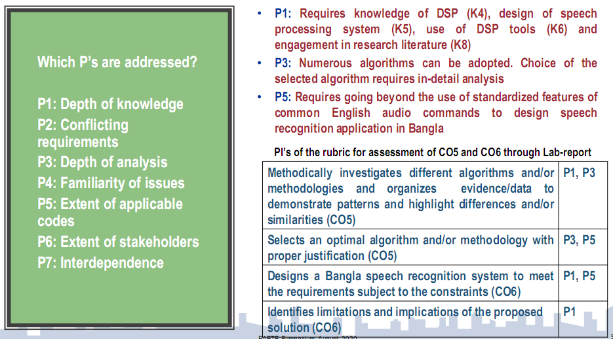
Complex Engineering Problem

Slide 22
Project Proposal (Next lab)
Project Title
Project Member’s
Motivation
Problem Definition
Objective, Solution & Project Outputs
Impact on Society
Critical challenges
Conflicting requirement
How P and K s are addressed through the project and mapping
Project Management (Time-table) and Cost analysis

Slide 23

Thanks to All

